Slide 1
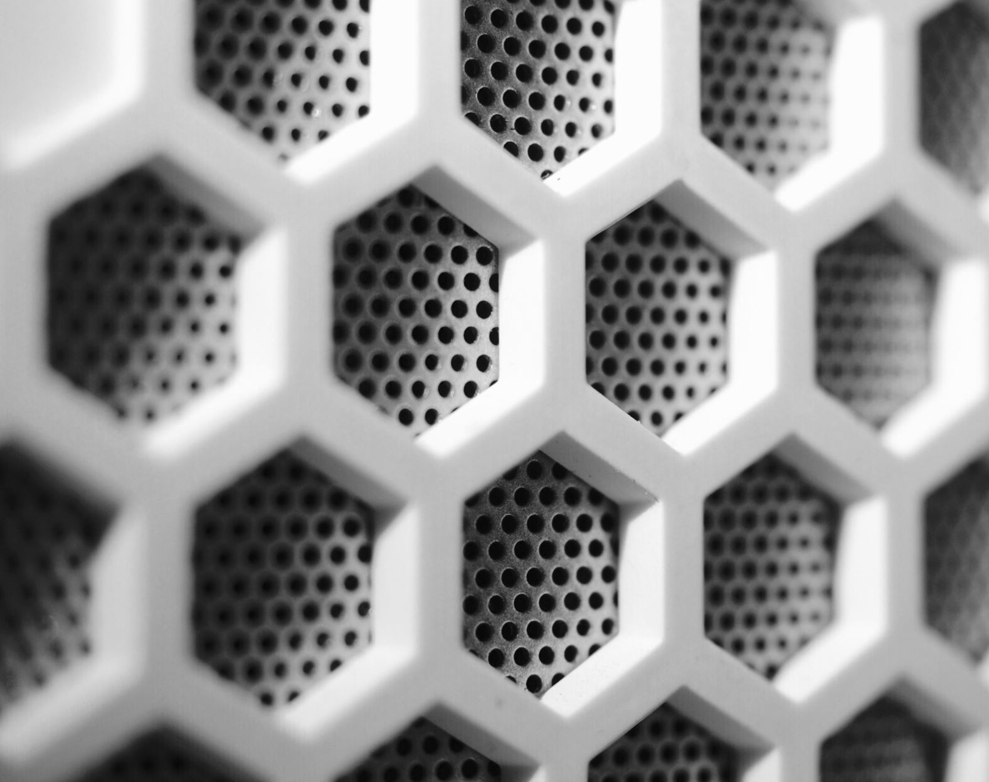
Acoustic Side Channel Attacks: Keystroke Sound Analysis
Akshay Paluri
Hyun Ho Kim
Kundan Singh Mahato

Slide 2
Table of Contents
Overview
Acoustic Side Channel Attack
Accomplishments
Background
Importance of Acoustic Side Channel Attack
Technical Details
Project
Code
Demo
Conclusion
Mitigation Strategies
Future Topics
Notes:
We will briefy go over what acoustic side channel attack is
And Background how it affects, Impact on security,
And what our project is and how it works
And how to mitigate and summary

Slide 3
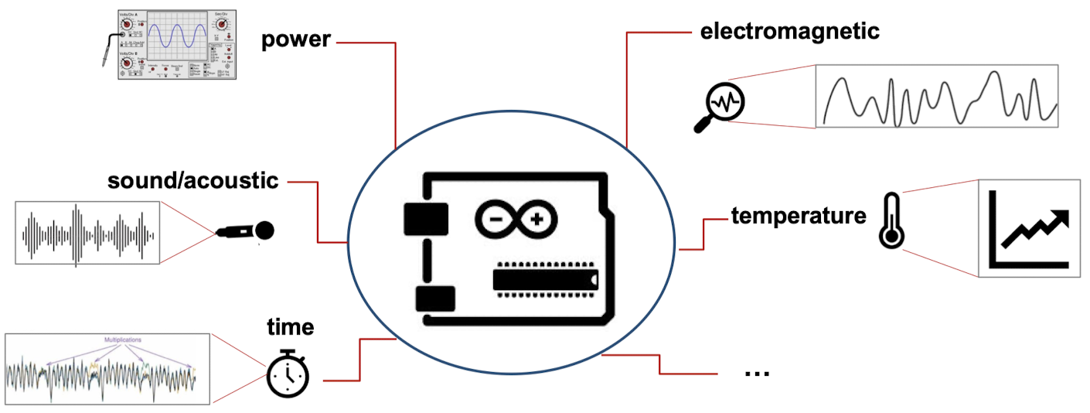
Types of Side Channel Attacks
Popular Side Channel Attacks
Power
Acoustic
Timing Attack
Electromagnetic
Temperature
Etc..

Slide 4
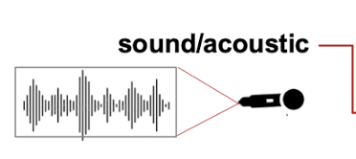
Acoustic Side Channel Attack
Audio emanations from a device can potentially expose vulnerabilities
Devices that emit sounds can be exploited to these attacks
The sounds produced during an action might differ slightly from one event to another
The sounds may be similar to the human
Notes:
Audio emanations from a device can potentially expose vulnerabilities, leading to side channel attacks

Slide 5
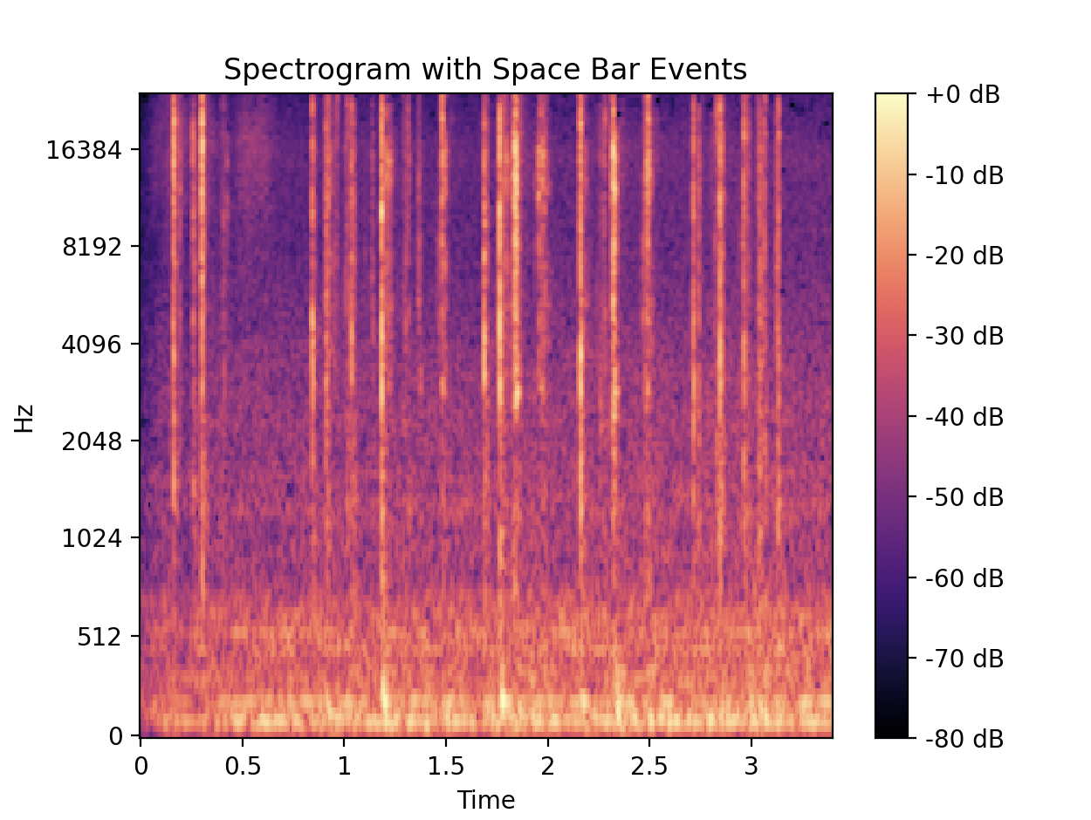
Accomplishments
Noise Normalization
Signal Conversion
Signal Visualization
Feature Extraction
Frequency Analysis
Space Bar Detection
Example of specrtogram
Notes:
This is our project accomplishments,
At the end of the demo, I will tell you guys know how we those work

Slide 6
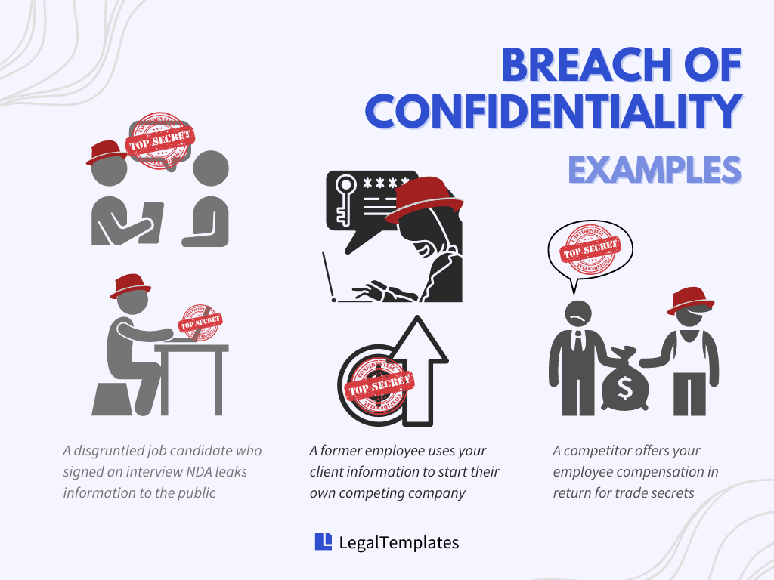
Importance of Acoustic Side Channel Attack
How it Affects Security
Secretly record the sounds
Use hidden microphones to capture keystroke acoustics
Implication
Confidentiality Breach - Risks sensitive information being decoded from keystroke sounds
https://legaltemplates.net/resources/business/handling-confidentiality-breach/

Slide 7
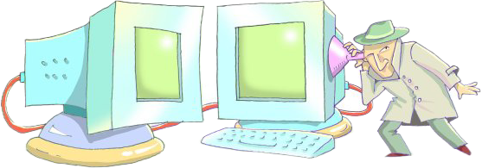
Technical details
How it Works?
Feature Extraction Process
Analyze frequency values
Identify patterns
Establish a standard or threshold
Classify each pattern
https://www.cs.tau.ac.il/~tromer/acoustic/
Notes:
Analyze frequency values to discern audio characteristics indicative of different keystrokes
Identify patterns associated with specific keys or actions
Establish a standard or threshold for distinguishing between these patterns
Classify each pattern to match it with the corresponding keystroke

Slide 8

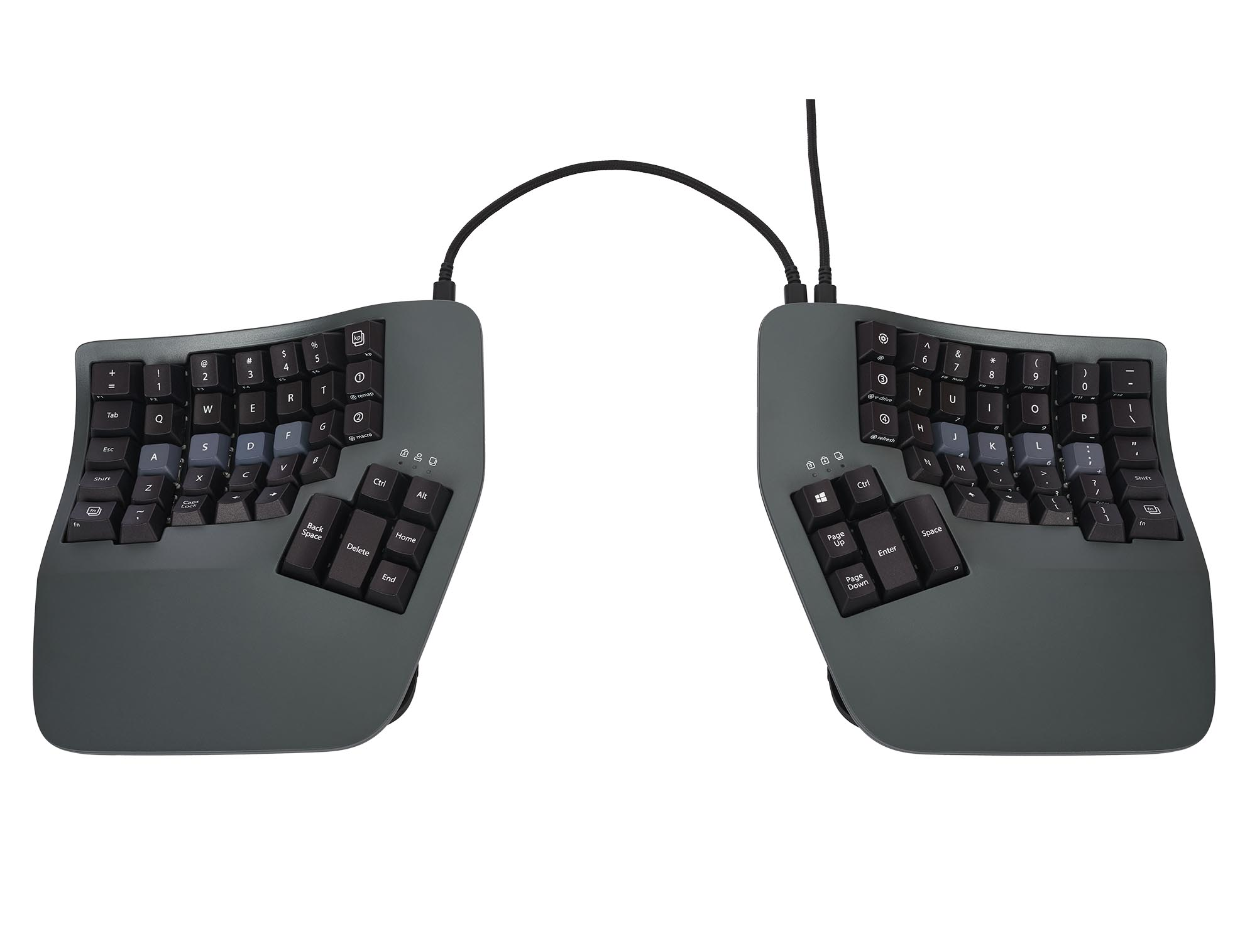
Challenges of Acoustic Side-Channel Attacks
High levels of background noise
Variability in typing speed and behavior
The diversity of keyboard types (mechanical, membrane, customized, or virtual)
Poor recording quality or microphones with low sensitivity
Notes:
High levels of background noise, which can mask keystroke sounds and complicate acoustic analysis.
Variability in typing speed and behavior, leading to inconsistent sound patterns that are difficult to detect.
The diversity of keyboard types (mechanical, membrane, customized, or virtual), each producing unique sounds requiring tailored analysis methods.
Poor recording quality or microphones with low sensitivity, resulting in insufficient data capture that hinders effective sound analysis.

Slide 9
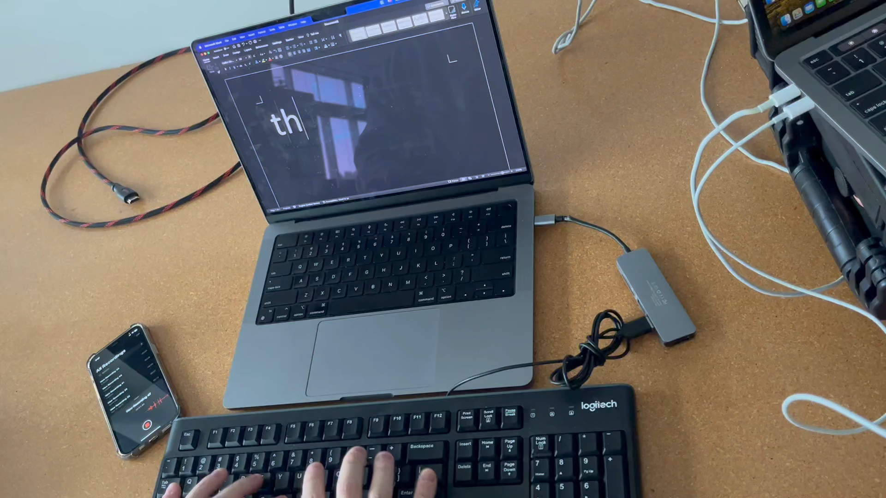
Key Idea of Our Project
Goal: Count words by detecting 'space bar' keystrokes as word separators
Analyze keystroke sounds using an acoustic frequency table to identify the unique acoustic pattern of 'space bars’
Example sentence: ”this is a test" — will count 3 'space bars', indicating a count of 4 words.

Slide 10
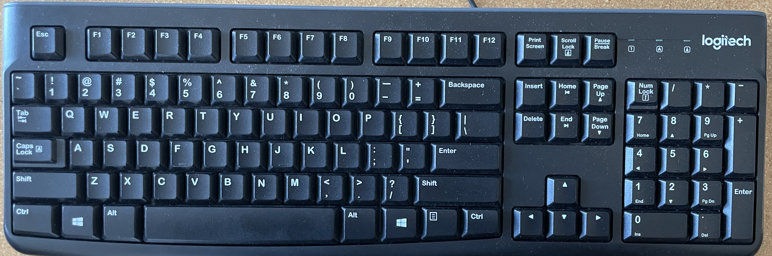

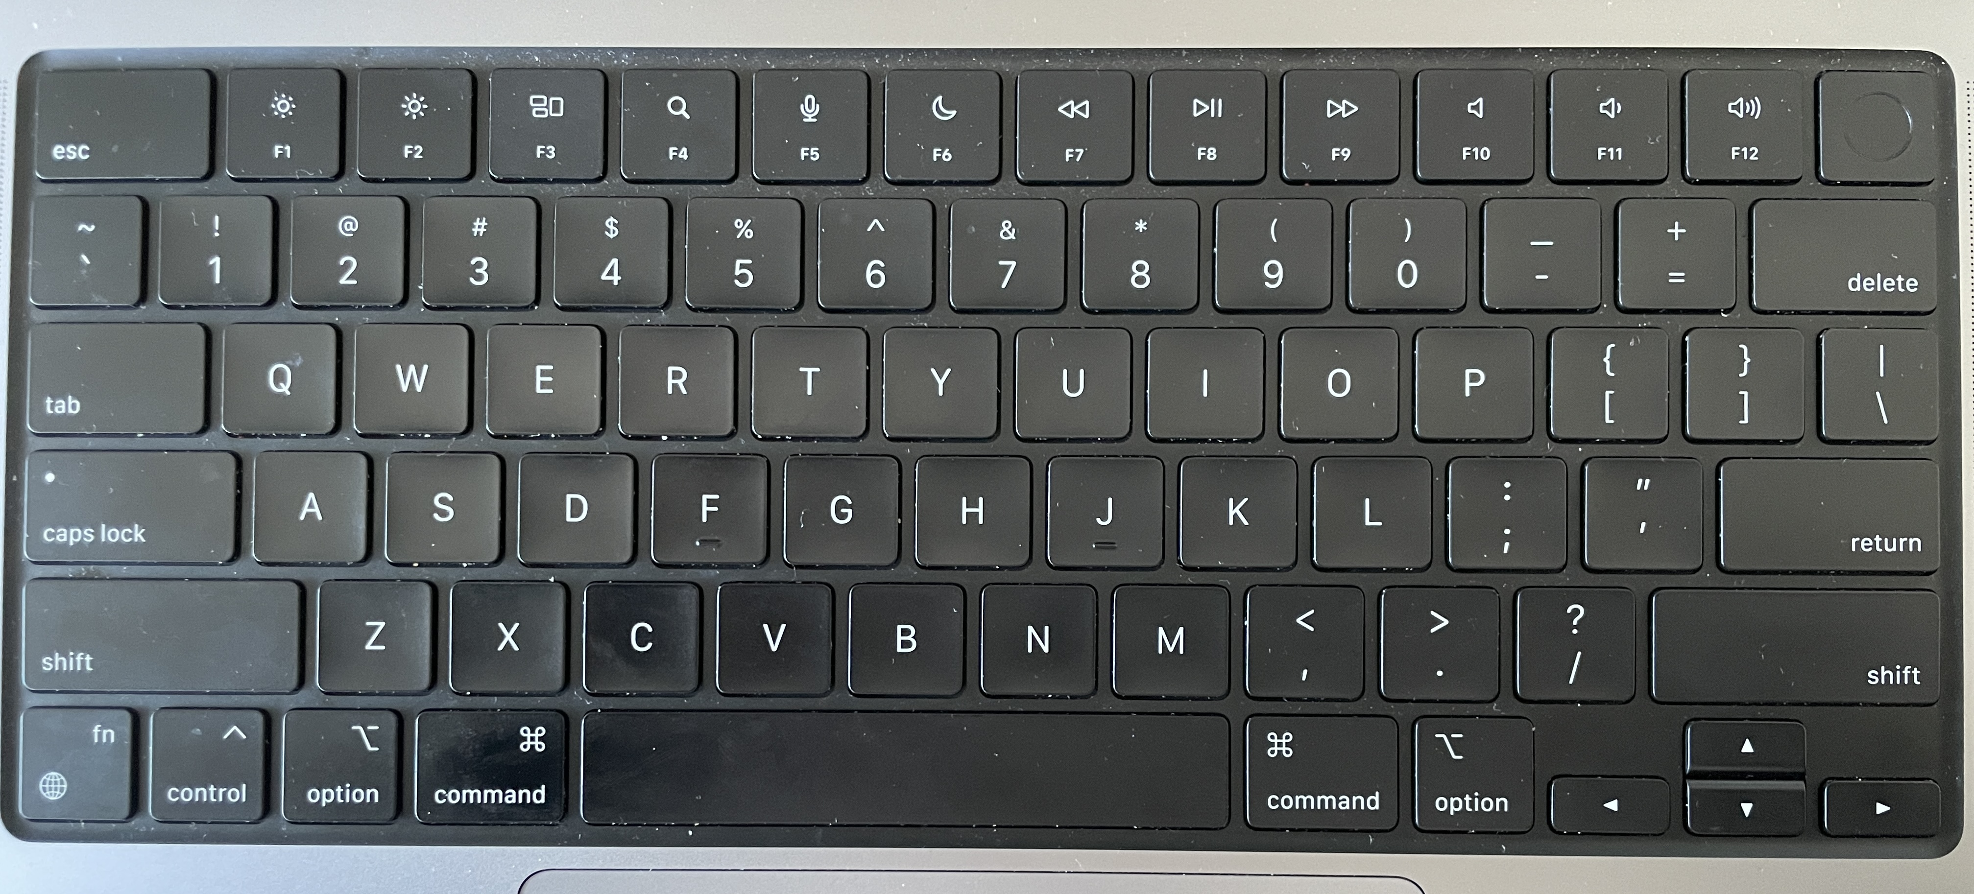
Why Focus on the Space Bar?
Larger Size
Unique Acoustic Signature – more hollow
Comparison with Other Keys
- Membrane keyboard
- Macbook keyboard
Logitech Keyboard K120
Macbook scissor switch keyboard
Notes:
Larger Size: The space bar is the largest key on the keyboard, which often results in a more distinct sound profile.
Unique Acoustic Signature: Due to its size and construction, the space bar is typically more hollow than other keys, offering a unique acoustic signature that is easier to isolate.

Slide 11


Assumption
Standard keyboard
X mechanical, X silicon, or X unique
Type normally
Press one key at a time
Quiet environment

Slide 12
Project Steps
1. Recording Conversion
- Captured keystroke sounds using an iPhone microphone and converted the recordings to .wav format for analysis
2. Noise Reduction
- Applied audio normalization techniques to reduce noise in sound recordings, enhancing clarity
3. Digital Signal Processing
- Converted acoustic input into digital signals, enabling detailed analysis of sound characteristics
4. Space Bar Detection Algorithm
- Identified the 'space bar' keystrokes by their distinctive audio properties: louder volume and longer duration
5. Continuous Analysis
- Monitored the entire duration of the sound file, counting keystrokes that met the 'space bar’ condition

Slide 13
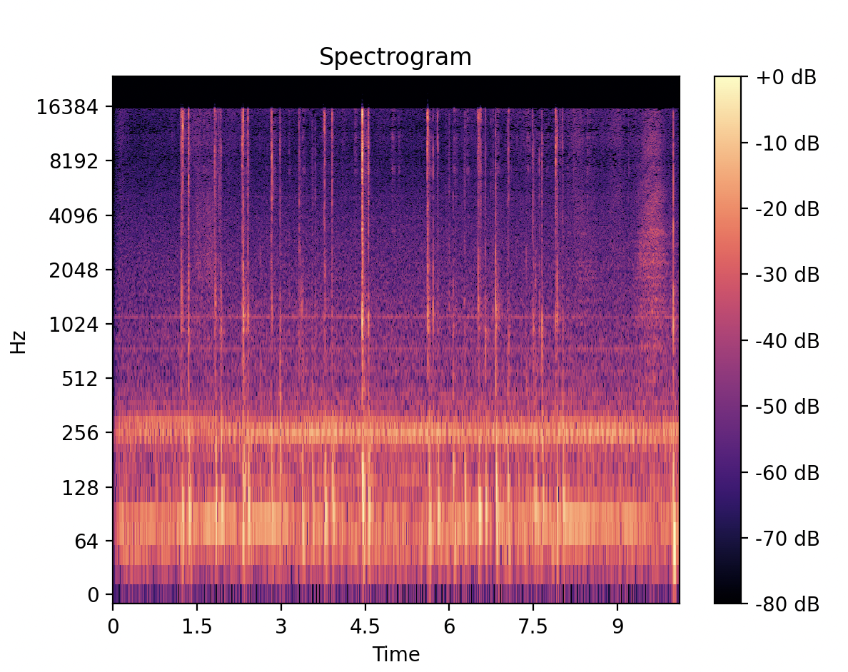
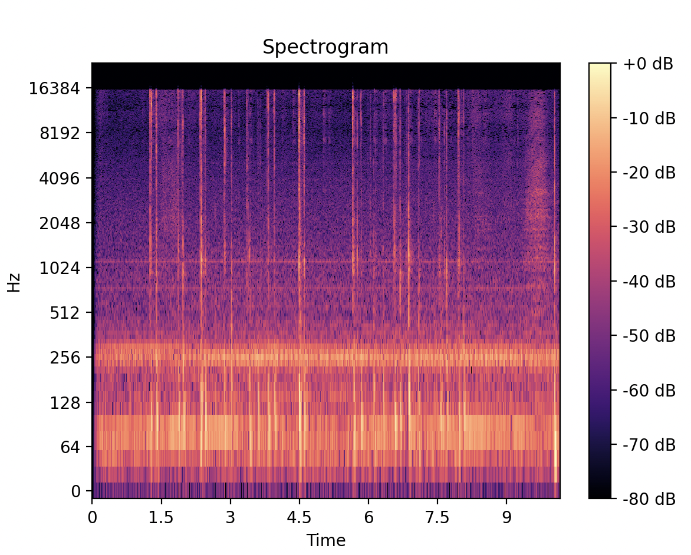
Normalization
Before normalization
After normalization

Slide 14
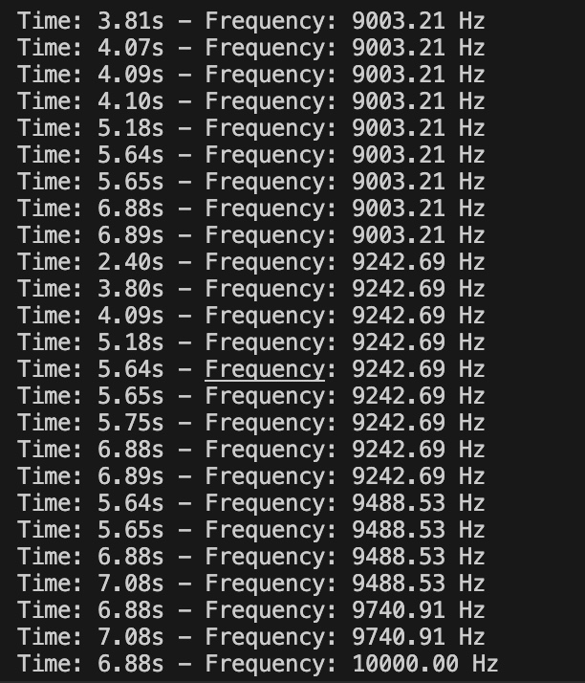
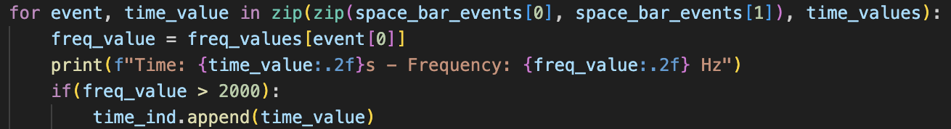
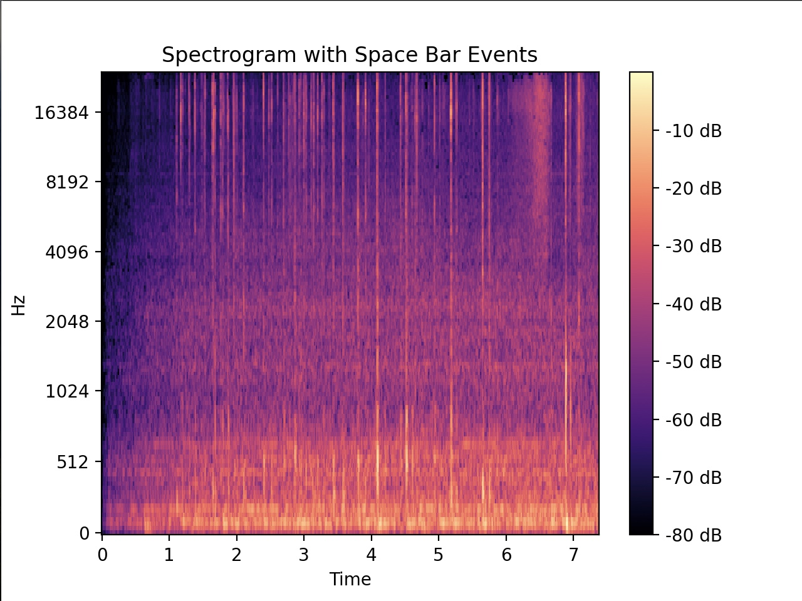
Frequency Reading
Code:

Slide 15
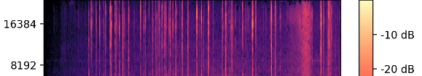
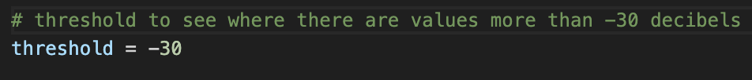
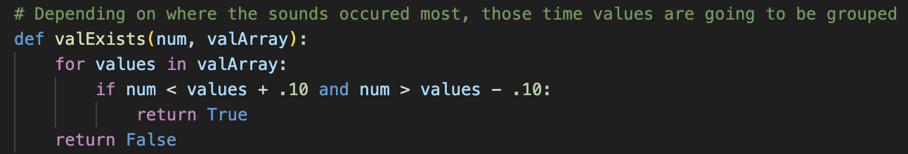
Space Bar Detection Algorithm
Frequency range focus
Experimentally derived a threshold value to effectively distinguish space bar keystrokes
Threshold <-30 dB,
Time duration (± 0.1)

Slide 16
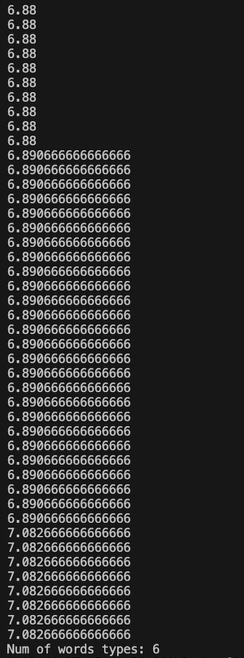
Check
While end of the file
If event >= 15
print (time)
count+1
Else,
It is not a ‘space bar’

Slide 17
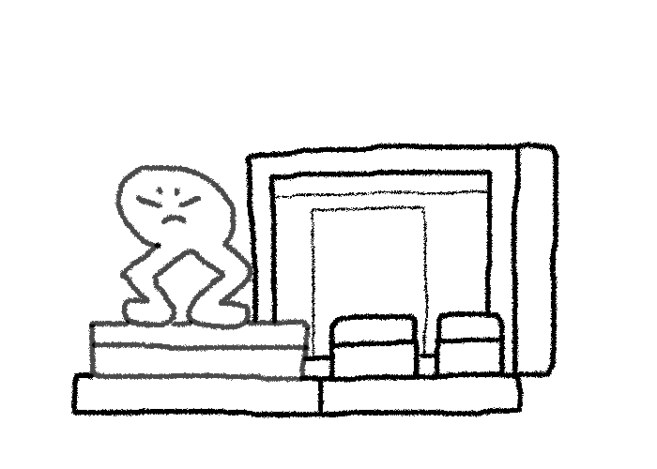
With the Space Bar Detection Technique
Various sound files and keyboards to identify the patterns
Attempted to count individual letter sounds from typing to assess the potential for data leakage
Analyzed the unique acoustic signatures of the space bar to differentiate it from other keystrokes
Notes:
Conducted a detailed analysis of keystroke sounds across various sound files to identify consistent typing patterns

Slide 18
Mitigation Strategies
White noise in the background making it harder to capture acoustic signal.
If handling sensitive data, use more isolated space or room.
Careful inspection of your surroundings, to identify an acoustic side channel attack.

Slide 19
Conclusion
Acoustic side-channel attacks pose a significant threat to the core security principles of Confidentiality, Integrity, and Availability.
There is a potential for attackers to eavesdrop on sensitive information by analyzing keystroke sounds
Counting the number of keys typed provides insight into user behavior and data leak vulnerabilities
Machine learning can be used to predict commonly typed words by analyzing keystroke sound patterns and extracting relevant features
Real-time processing

Slide 20
Q&A
Any Question?

Slide 21
References
Acoustic Side-Channel Attack using machine learning
https://web.archive.org/web/20180409221150id_/http://www.ijcscn.com/Documents/Volumes/vol3issue1/ijcscn2013030103.pdf

